Slide 1
QUALITY ASSURANCE
&
Software Testing

Slide 6
Software testing
Software testing: is a method to check whether the actual software product matches expected requirements and identify errors, gaps or missing requirements to ensure that software product is Defect free as much as possible.
So by finding defects, we increase the quality of the software and reduce the risk associated with the software.

Slide 7
What is the need of Testing?
.

Slide 8
Faulty Software
If the software does not work correctly, such software is are called faulty software.
Impact of faulty software:
Loss of money.
Loss of time
Loss of reputation and
Injury or death

Slide 11
Software Development Life Cycle (SDLC)
SDLC is a process that creates a structure of development of software. There are different phases within SDLC, and each phase has its various activities. It makes the development team able to design, create, and deliver a high-quality product.

Slide 12
Software Testing Life Cycle (STLC)
STLC is a sequence of specific activities conducted during the testing process to ensure software quality goals are met. STLC involves both verification and validation activities.

Slide 13
Explain the STLC – Software Testing life cycle
Requirement analysis and validation – In this phase, the requirements documents are analyzed and validated and the scope of testing is defined.
Test planning – In this phase, the test plan strategy is defined, the estimation of test effort is defined along with the automation strategy, and tool selection is done.
Test Design and Analysis – Here, test cases are designed, test data is prepared and automation scripts are implemented.

Slide 14
Test environment setup – A test environment closely simulating the real-world environment is prepared.
Test execution – The test cases are prepared, bugs are reported and retested once resolved.
Test closure and reporting – A test closure report is prepared to have the final test results summary, learning, and test metrics.

Slide 19
Types of Software Testing

Slide 23
Unit testing is the first level of testing and it involves testing individual modules of the software. It is usually performed by developers.
Integration testing is performed after unit testing. In integration testing, we test the group of related modules. It aims at finding interfacing issues between the modules.

Slide 24
System testing is performed on a complete, integrated system. It allows checking system’s compliance as per the requirements. It tests the overall interaction of components, System testing most often the final test to verify that the system meets the specification.
Acceptance testing is a test conducted to find if the requirements of a specification or contract are met as per its delivery. Acceptance testing is basically done by the user or customer.

Slide 25
Testing Documentation

Slide 26
Test Scenarios:
It is a document that defines the multiple ways or combinations of testing the application. Generally, it is prepared to understand the flow of an application. It does not consist of any inputs and navigation steps.
Test case:
It is an in-details document that describes step by step procedure to test an application. It consists of the complete navigation steps and inputs and all the scenarios that need to be tested for the application.

Slide 27
Test plan:
It is a document that is prepared by the managers or test lead. It consists of all information about the testing activities. The test plan consists of multiple components such as Objectives, Scope, Approach, Test Environments, Test methodology, Template, Role & Responsibility, Effort estimation, Entry and Exit criteria, Schedule, Tools.
Requirement Traceability Matrix (RTM):
The Requirement traceability matrix [RTM] is a document which ensures that all the test case has been covered.

Slide 28
Test strategy:
The test strategy is a high-level document, which is used to verify the test types (levels) to be executed for the product and also describe that what kind of technique has to be used and which module is going to be tested.
Test data:
- It is data that occurs before the test is executed. It is mainly used when we are implementing the test case. Mostly, we will have the test data in the Excel sheet format and entered manually while performing the test case.
- The test data can be used to check the expected result, which means that when the test data is entered, the expected outcome will meet the actual result and also check the application performance by entering the in-correct input data.

Slide 29
Bug report:
The bug report is a document where we maintain a summary of all the bugs which occurred during the testing process. This is a crucial document for both the developers and test engineers because, with the help of bug reports, they can easily track the defects, report the bug, change the status of bugs which are fixed successfully.
Test execution report:
It is the document prepared by test leads after the entire testing execution process is completed. The test summary report defines the constancy of the product, and it contains information like the modules, the number of written test cases, executed, pass, fail, and their percentage. And each module has a separate spreadsheet of their respective module.

Slide 30
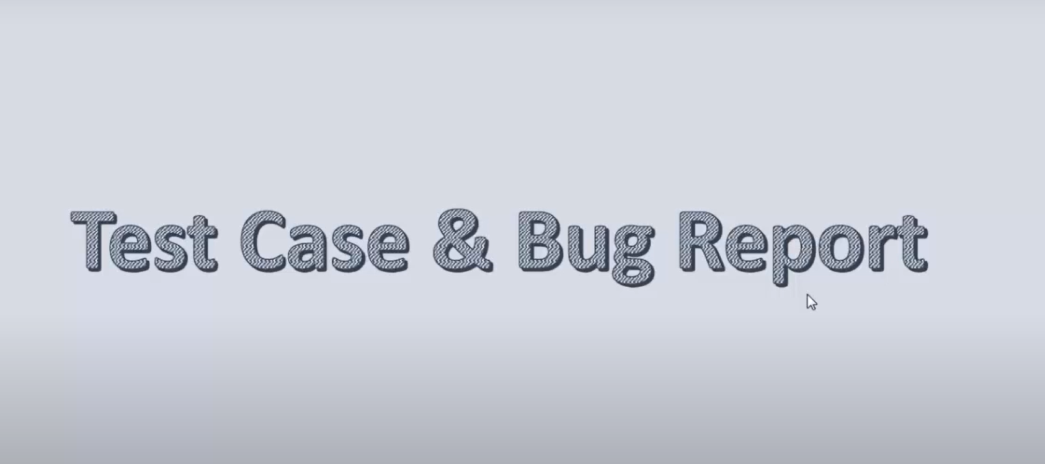

Slide 31
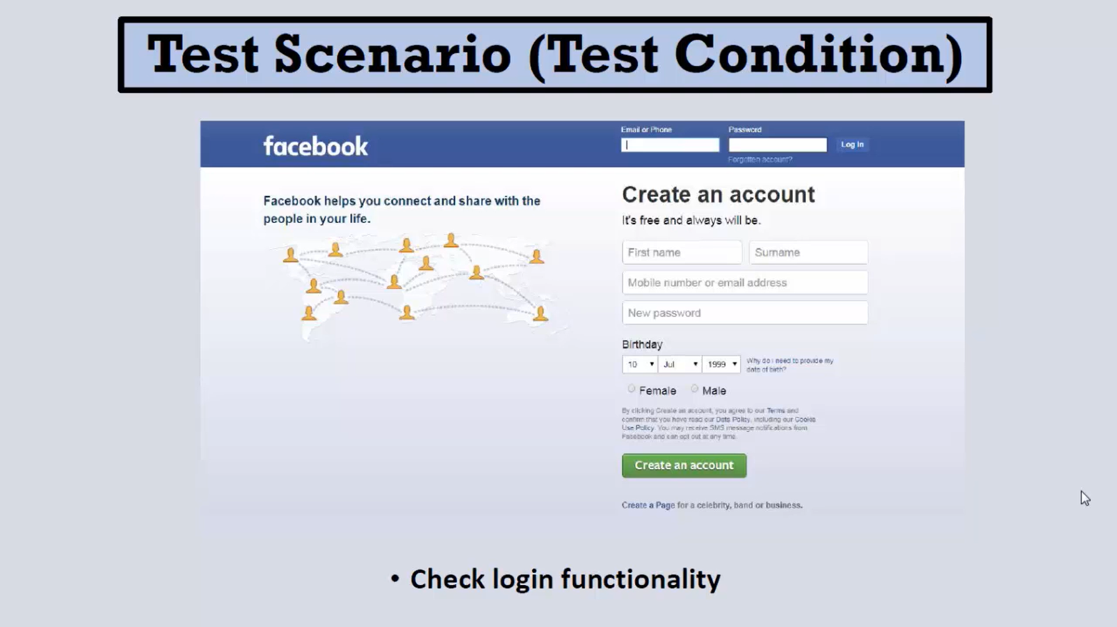
How to write a test case

Slide 32
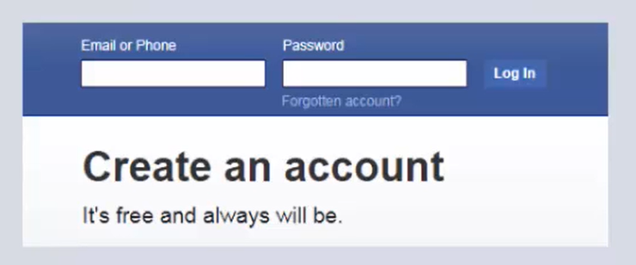
Test case:
Test data:
-user name=…….
-password= …….

Slide 33
Expected result:
Login successful and website opens.
Test steps:
Open www.facebook .com
Enter user name
Enter password
Click login

Slide 34
Pre-condition:
Is a statement or set of statements that outline a condition that should be true when an action is called.
The precondition statement indicates what must be true before the function is called;
example:
user is already registered.

Slide 35
Expected result:
A page displaying the Facebook home page should load.
Actual result:
Actual Result is the result that tester gets when performs a test case.
Status:
Pass or fail.

Slide 36
How to write a bug report
Title
Steps of reproduce
Expected result
Actual result
Severity (Critical , Major , Minor)
Priority ( High , Medium , Low)
Screenshot or Video

Slide 44
manual testing & automation testing
* Manual testing :
is a type of testing that involves validation of the requirements of the application by executing a predefined set of test cases manually without the use of any automation tool.
* Automation testing:
is a type of software testing that involves automated test case execution using an automation tool. It helps in reducing the test execution time as the test scripts written once, can be run automatically any number of times without any human intervention.

